Slide 1

Smart Curated CCTV system
Increased security . better liability . smart processing

Slide 2
Every 3 seconds, one property crime is occurring somewhere around the world.
Which means by the time you just finished reading this, one crime has already taken place.
-data by the FBI

Slide 3
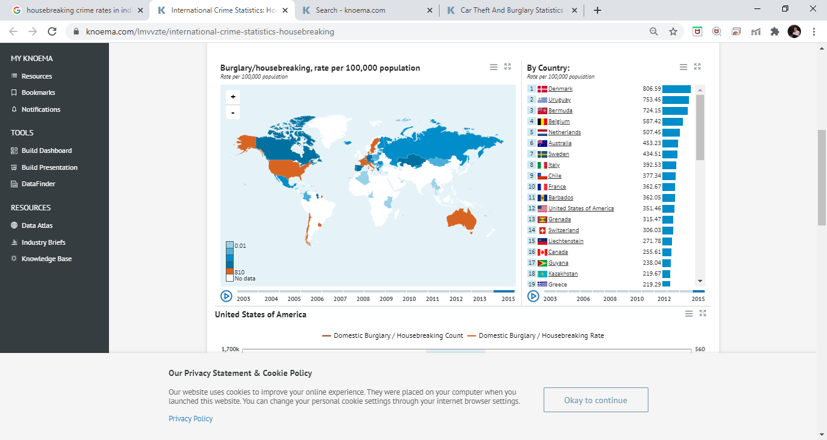
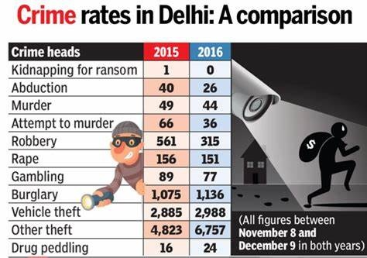
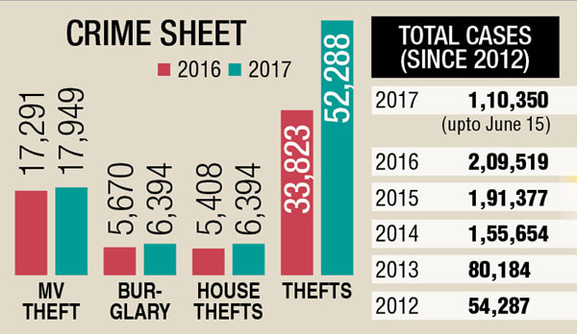

Slide 4
Lets talk facts…
Most criminals can burglarize a house in under 10 min.(so do we have time?)
Most burglaries take place between 10am and 3pm. (when people are at work)
A residence without a home security system is up to 300% more likely to be burglarized
The average property loss in just the US $2799.
LESS THAN 14% OF BURGLARIES RESULT IN ARREST. (absence of evidence)
Buying a set of keys for $20 will unlock 9 out of 10 locks
77% of all crimes are property crimes.
Identity theft is the fastest growing crime in the U.S., Canada, and UK.
3 out of 4 homes in the U.S. will be broken into within the next 20 years.
The global security services is a $116 billion industry yet only 14 out of 100 burglaries arrested.
The security guards vs police officers ratio proves for the inefficiency of the system : India(7M , 1.4M) , China(5.7M-2.7M)
A report published by the University of North Carolina found that about 60% of convicted burglars stated that the presence of a security system influenced their decision to target another home.
-Data from the home burglary statistics 2019 and 2020 state of Safety Survey

Slide 5
Threats, problems and challenges
Crime detection & criminal identification
None to overlook
Inefficient security forces
Uncertainity & benefit of doubt
Revenue lost in inefficient security systems
Response time and delays in action

Slide 6
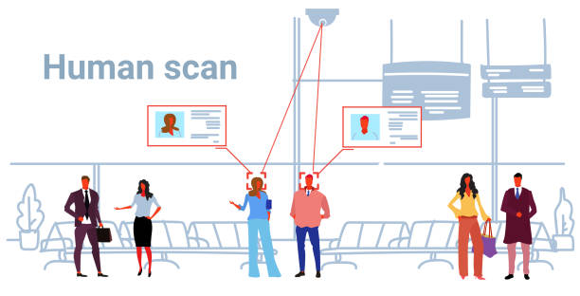

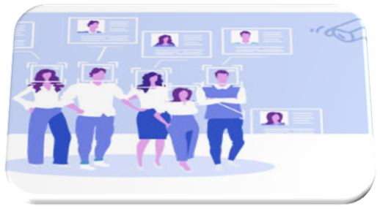
The Model and Working Face recognition techniques >> human scan >> sends alerting message to owner

Slide 7

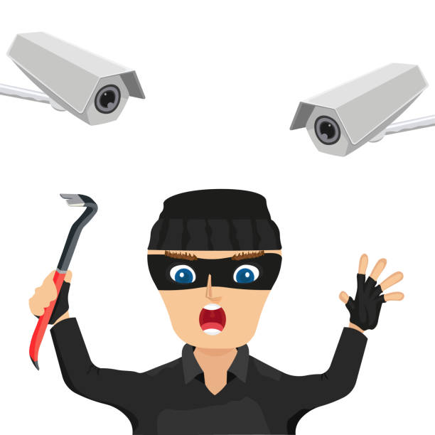

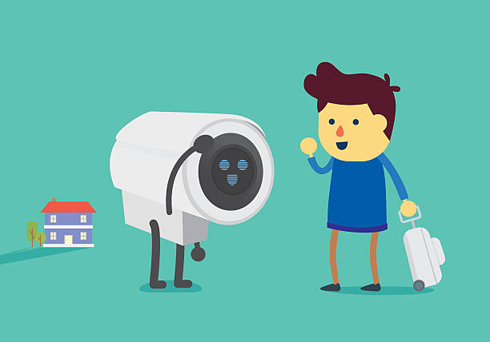
Confirms for identification >> rings alarms >> alerts the police and neighbours >> sends image and location details to security

Slide 8
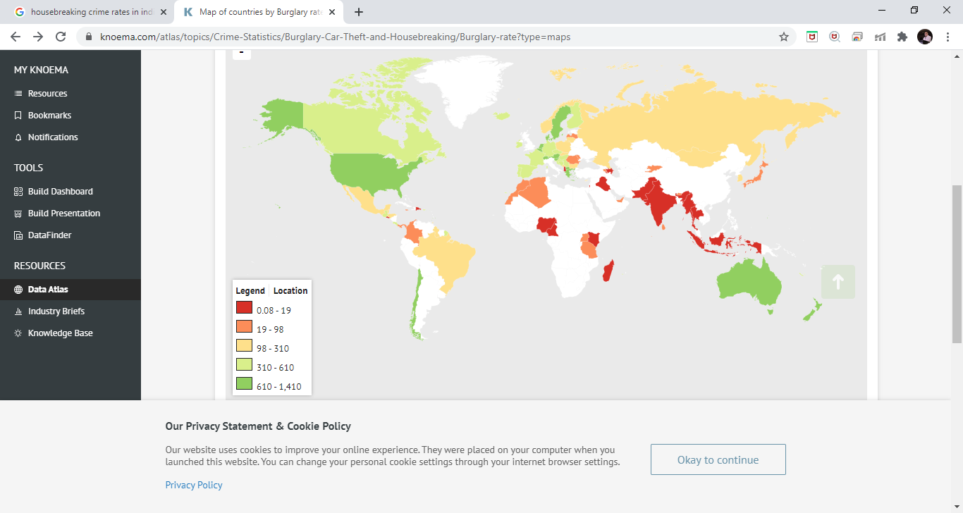
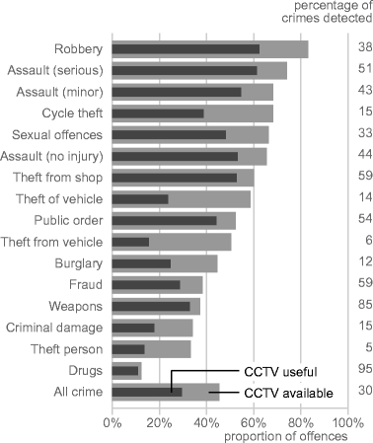
Benefits to the World and the Society
The rates of property thefts, robberies and burglary(2015)
All these extremely prominent crimes can be prevented.
The smart CCTV will prevent and ensure security in all the genres directly, and many others indirectly.
Data from South Africa
Efficient, full-proof security system available for every household. Will cut the extra security charges.

Slide 9
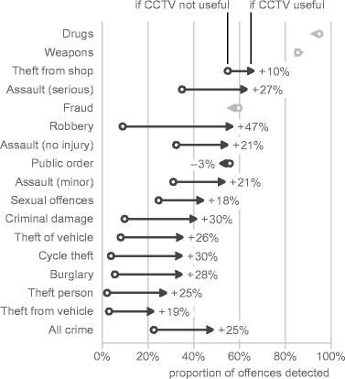
Benefits to the World and the Society
Approximately 83% of convicted thieves say they attempt to determine if homes have security systems before trying to commit burglaries, According to Angie's List.
Most countries have a 2:1 or higher security guard to police officer ratio. The smart curated CCTV system handles this work.
1 out of 4 burglars cut security system or phone wires before they enter the home. This is a major reason to consider using an alarm with wireless monitoring.
Helps massively in criminal detection, identification, location report, instantaneous procedural action.

Slide 10
Well, we have got all of these covered with our SMART CURATED CCTV SYSTEM !
LET’S HAVE A LOOK AT THE
VIDEO THAT WILL HELP YOU ALL
TO UNDERSTAND THE IDEA
BETTER!!

Slide 11


